Slide 1
Automated Lip Reading
Instructor: Lee-Ad Gottlieb, Ph.D.
Team Members: Tal Noam, Evgeny Vendrov, Amitai Zamir.

Slide 2
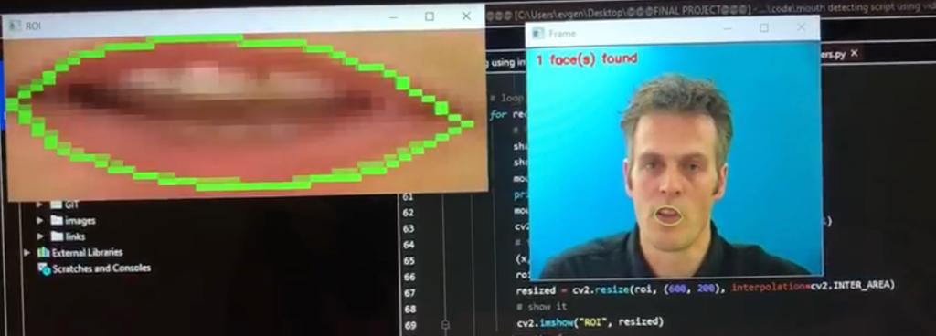
Our Purpose:
Our goal is to develop a machine learning algorithm, based on a DNN architecture, which is “trained” to extract spoken letters out of a voice-less video of a speaking person, based on the movement of speakers lips.

Slide 3
Studies We Base Our Project On
This first is “LIPNET: END-TO-END SENTENCE-LEVEL LIPREADING”(2016) by Yannis M. Assael, Brendan Shillingford, Shimon Whiteson & Nando de Freitas, from the Department of Computer Science, University of Oxford, Google DeepMind and CIFAR.
The Second is “Lip2AudSpec: Speech reconstruction from silent lip movements video”(2017) by Hassan Akbari, Himani Arora, Liangliang Cao and Nima Mesgarani from the department of Electrical Engineering, Columbia University. Please notice, that in this study, the problem researched is “bigger” then only reading lips, but we thought that the DNN architectures used for the ALR part can be useful for us to base on.

Slide 4
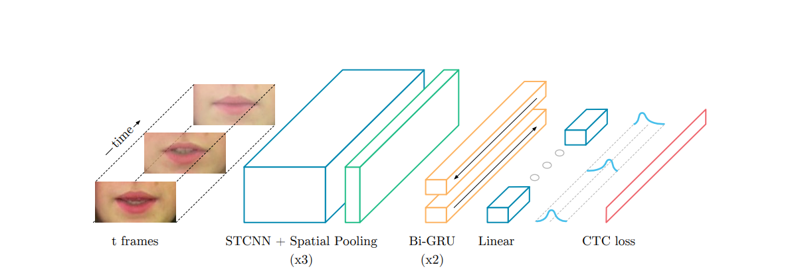
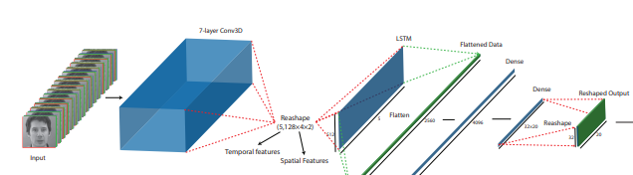
Architecture We Base On:
“LIPNET” architecture:
“Lip2AudSpec” architecture: (only the relevant part)

Slide 5
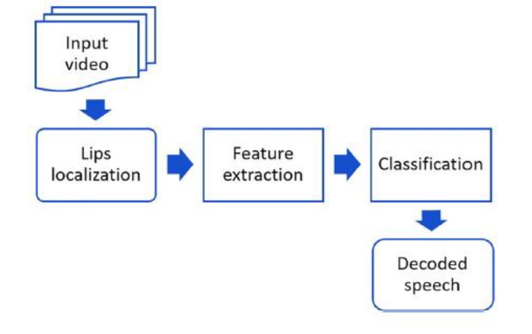
Architecture We Base On (cont.)
As we can see – both systems are built very similarly, the basic concept is using this kind of “pipeline”:
Input video is a data point from the data set – which has to contain a person speaking in front of the camera – and a matching text file of everything was said.
Lips localization can be done using already trained CNN from OpenCV library.
Feature extraction from the already localized lips is done using a CNN – this one we have to train.
Classification is done using some kind of RNN – we saw that “LIPNET“ used two layers of Bi-GRU while “Lip2AudSpec” used many layers of LSTM.
Decoding the speech is done by flattening the output layer of the RNN and passing it through SoftMax output layer.
Loss is calculated using CTC or Cross Entropy and is the difference between what the has model predicted and the text matching to the actual speech.

Slide 6
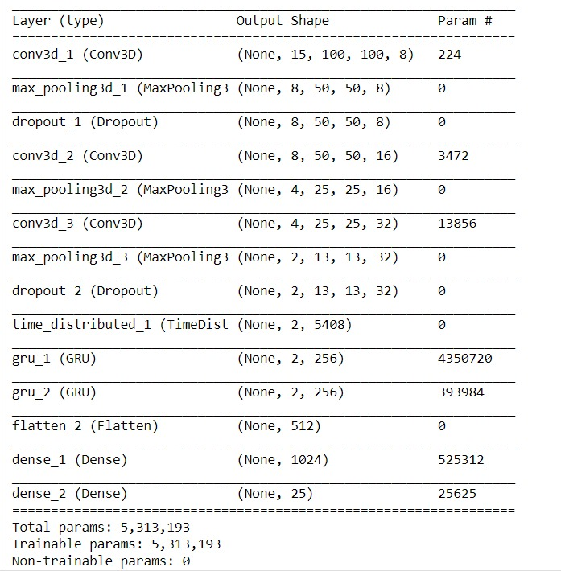
Architecture was actually used

Slide 7
What Is Done – What Has To Be
We have collected a large and rich data set of “speaking heads” videos – with matching text files of what has been said.
We have succeed using OpenCV on the dataset videos to extract lips, and we already got the scripts to pre-process the data (i.e. extract lip frames every x seconds/frames)
We have succeed using AWS “SageMaker” and “S3” to run basic ML algorithm on its data set (only as a test)
Now, our next mission is preprocessing the data set on AWS (we deal with videos which makes it a hard computing mission – so it almost can’t be done on plain laptop)
Then we have to start training the model we described and adjusting it to the preform better.

